Slide 1
Experts Architectural Diagrams
Last updated August 16, 2019

Slide 2









Data Ingress
Injecting data into Marketing Cloud
SALESFORCE MARKETING CLOUD
CONTACT DATASET(S)
BULK DATA INPUT
DATABASE(S)
ETL
sFTP
IMPORT
CUSTOMER DATA
PURCHASE DATA
WEB ANALYTICS
SHIPMENT DATA
MC CONNECT
Standard and Custom Objects Secure API
1:1/1:Many
REST/SOAP REQUEST
SYNC or ASYNC
CONTACT BUILDER
REST/SOAP RESPONSE

Slide 3
Data Egress
Extracting data from Marketing Cloud
CHANNEL SYSTEM VIEWS
DATA EXTRACT (BATCH TRACKING)
MOBILE
CONTACTS
LABEL
UNDELIVERABLE SMS
SUBSCRIBER SMS
PUSH ADDRESS
MOBILE ADDRESS
LABEL
CONTACTS
SUBSCRIBERS
Standard Tracking Extracts
Query Activities (SQL)
CSV
JOURNEYS
EMAIL
LABEL
JOURNEY
JOURNEY ACTIVITY
LABEL
SENT
OPEN
BOUNCE
CLICK
UNSUBSCRIBE
FTA
COUPON
COMPLAINT
LISTSUBSCRIBERS
Custom Criteria for deltas or other requirements
CSV
sFTP
DATABASE(S)
SOCIAL
LABEL
SOCIAL NETWORK IMPRESSIONS
SOCIAL NETWORK TRACKING
DATA EXTRACT (CSV, TAB, other)
Data Extension Extract

Slide 4






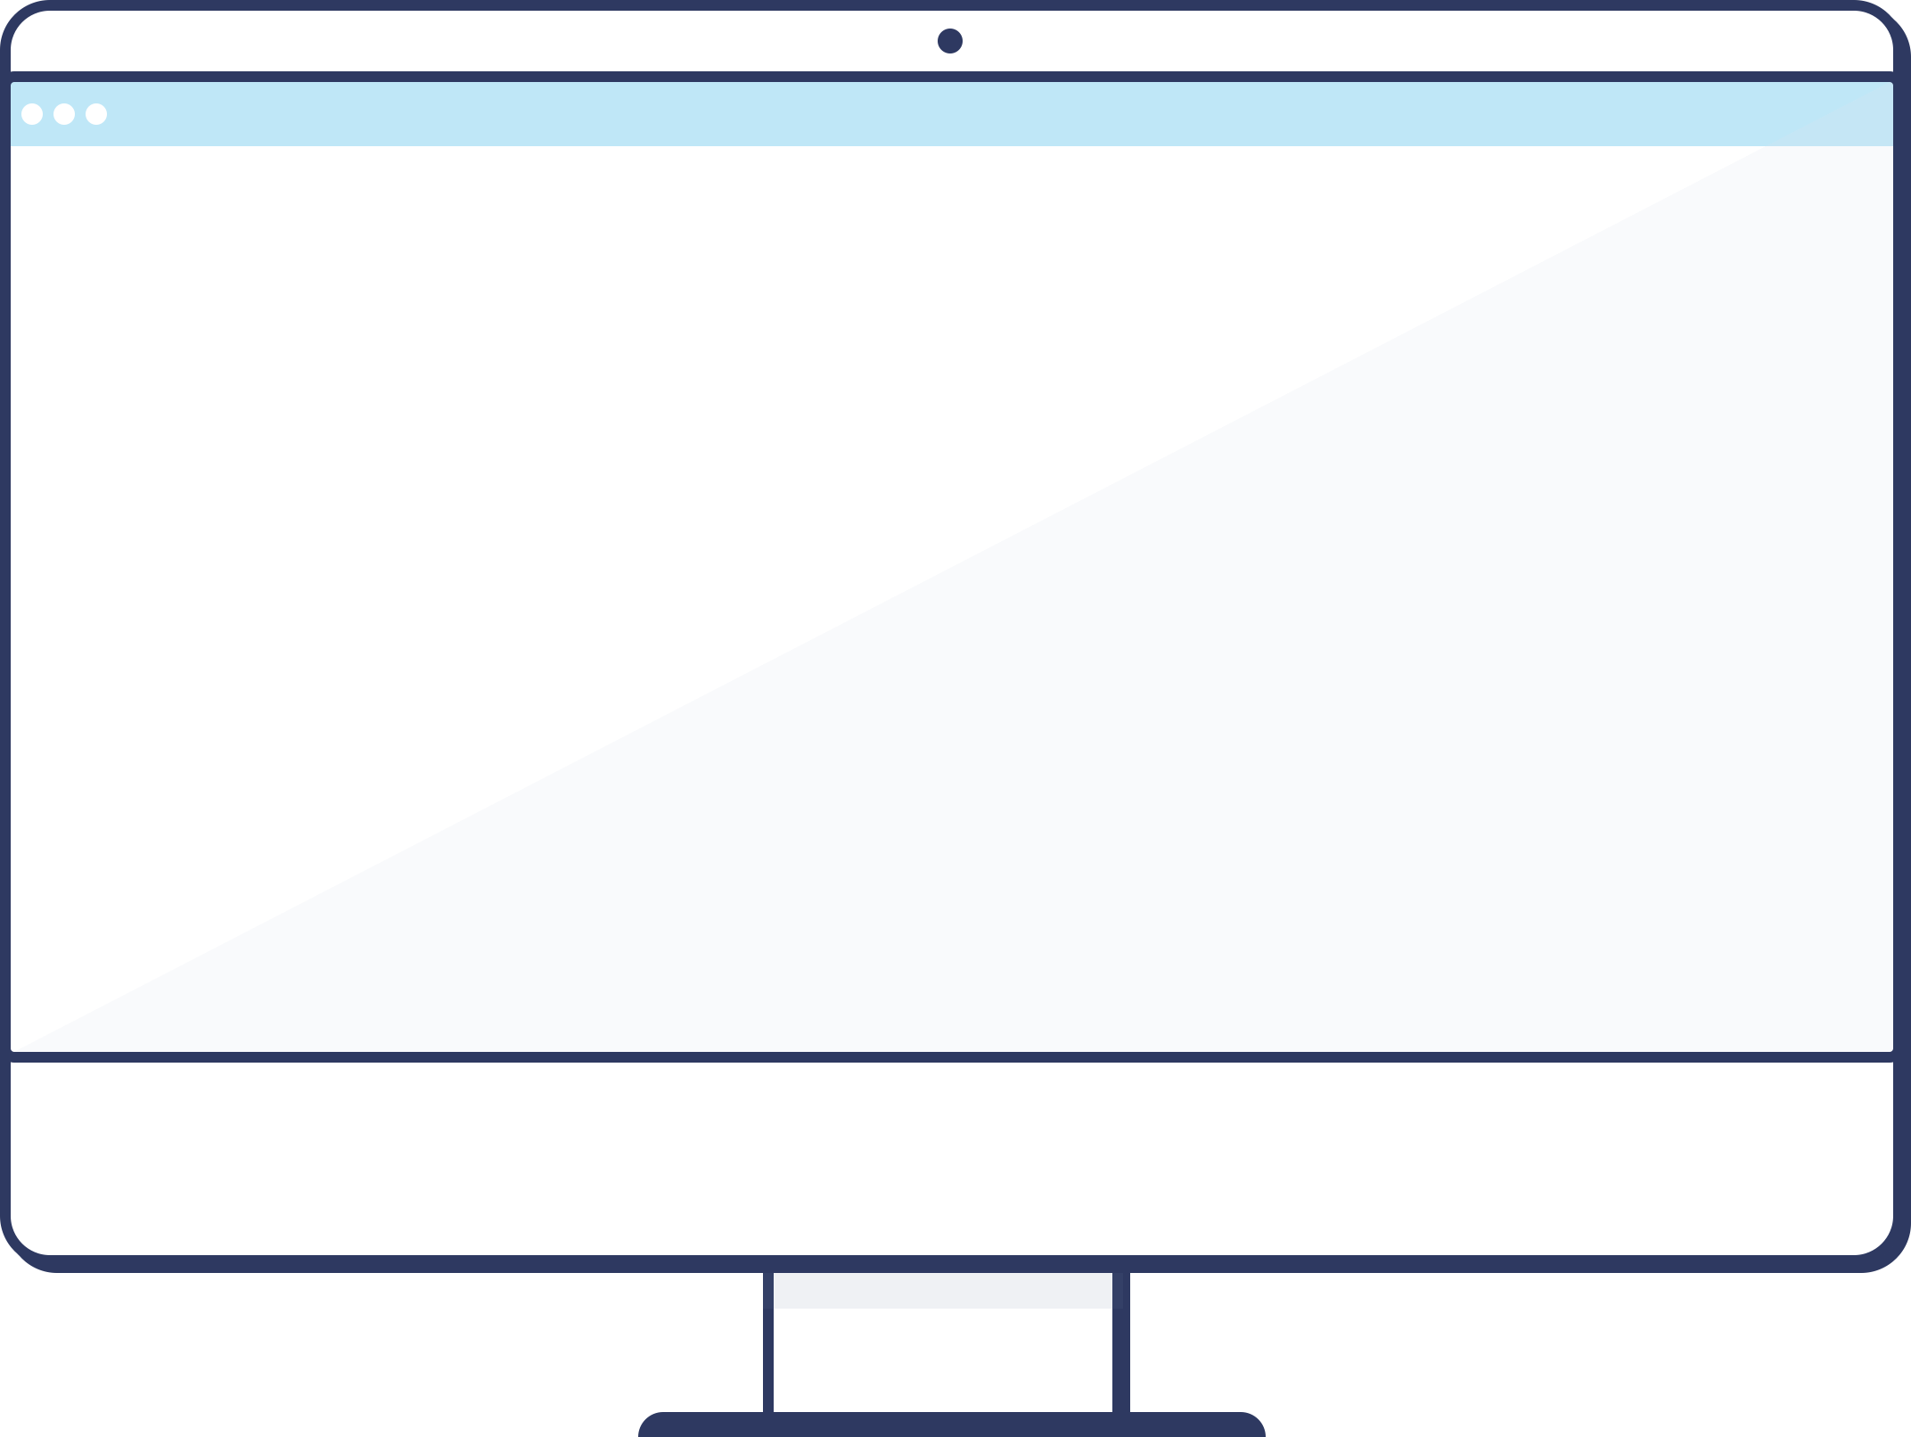



Data Integrations
Personalization, Segmentation, and Journey Management
Bulk Data Input (Nightly)
Contact Dataset(s)
[CUST] Database(s)
ETL
sFTP
Import Rule(s)
Customer
Data
Purchase
Data
Web
Analytics
Shipment
Data
CRUD Support on Data Objects
REST / SOAP API
SYNC or ASYNC
Real-time Data Input
(API – Individual)
Contact
Builder
[CUST] Endpoint
REST / SOAP API Response
Marketing
Cloud
Execution of Segment
Customer
Data
Purchase
Data
Web
Analytics
Shipment
Data
Contact Relationships
User-driven Segmentation
Audience Created

Slide 5



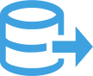

Data Retrieval
Data Retrieval (Large Sets)
Data Extract (Batch Tracking)
Contact Dataset(s)
_Bounce
_Click
_Complaint
_Coupon
_PushAddress
_SocialNetworkTracking
_FTAF
_Job
_ListSubscribers
_Open
_PublicationSubscriber
_Sent
_Subscribers
_MobileAddress
_Unsubscribe
Standard Tracking Extract(s)
Query Activities (SQL)
File Transfer
Custom criteria with joins/ grouping/etc for deltas or other requirements
Data Extract (CSV, TAB, other)
Automation
Studio
Data Extension Extracts
Retrieve any Object
REST / SOAP API
Real-time Data Input
(API – Smaller Sets, Service Use Cases)
SYNC or ASYNC
[CUST] Endpoint
REST / SOAP API Response

Slide 6







Journey Messaging Flows
Real time journey trigger events
1
Real-time Triggered Journeys (Notifications, Confirmations, Service Alerts etc.)
API Payload
Journey
KEY
EVENT(S) FLOW CONTROL MESSAGES
EMAIL VALUE/PAIRS
2
Marketing Cloud Triggered Journeys (Welcome Series, On-boarding, Re-engagement etc.)
Journey
Service Event
Lead or Contact Created/Updated
EVENT(S) FLOW CONTROL MESSAGES
Automation

Slide 7


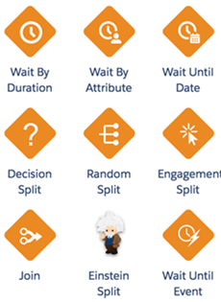




Journey Execution
Data set
Email
Flow Controls
Cloud Page
Text
Event
Notification
Google Analytics 360
Sales Cloud
Salesforce Data
Service Cloud
Audience Studio
DMP
Custom Activity

Slide 8

Real Time Journey Execution
Explicit Payload Per Journey
Example Payload:
{
"ContactKey":"12345",
"EventDefinitionKey":"journey1",
"Data": {
[Data]
}
}
MARKETING CLOUD
Journey 1
Example Payload:
{
"ContactKey":"12345",
"EventDefinitionKey":"journey2",
"Data": {
[Data]
}
}
Member Event
/interaction/v1/events
Journey 2
Triggered
Journey
Example Payload:
API
{
"ContactKey":"12345",
"EventDefinitionKey":"journey3",
"Data": {
[Data]
}
}
Journey 3
Example Payload:
{
"ContactKey":"12345",
"EventDefinitionKey":"journeyN",
"Data": {
[Data]
}
}
Journey N

Slide 9
Near Time Journey Execution
Master Event Data Extension Feeds Journey Specific Data Extensions
MARKETING CLOUD
Journey Builder
Data Extensions
15 Minute Max Intervals
Journey 1
Journey 1
Member Event
/hub/v1/dataevents/key:MASTEREVENTS/rowset
Master Event
Data Extension
Automation Studio
Journey 2
Journey 2
Data Extension
Insert
Master Event Table
API
Example Payload:
[
{
"keys":{
"ContactKey": "12345"
},
"values":{
[DATA]
}
}
]
Journey 3
Journey 3
Journey N
Journey N

Slide 10
Real Time Trigger, Batch Journeys
Initial email delivered in seconds, Journeys initiated in batches
MARKETING CLOUD
Journey Builder
Data Extensions
Member Event
Transactional Send
Data Extension
Journey 1
Journey 1
/messaging/v1/email/messages
Transactional
API Call
Transactional Send Table
Journey 2
Journey 2
API
Example Payload:
{
"definitionKey": "tapi-survey",
"recipient":
{
"contactKey": ”123",
"to": ”email@example.com",
"attributes":{
"key1":"value1"
}
}
}
Journey 3
Journey 3
Automation Studio
Journey N
Journey N

Slide 11
Marketing Cloud Business Unit Setup
Business Unit Setup - 1
Enterprise
Business Unit
AMER
LATAM
EUROPE
APAC
US
Sender Authentication Package
(Shared click redirect, Shared link wrapping, unlimited FROM name)
Consumer
2 Marketing IP Addresses (<6MM per day)
Commercial
1 Transactional IP Address (<3MM per day)
Canada
Managed Preference Center
Consumer
Commercial
BU Level
Opt-Out
BU Level
Opt-Out
BU Level
Opt-Out

Slide 12
Marketing Cloud Business Unit Setup
Business Unit Setup - 2
Enterprise
Business Unit
Dev
Business Unit
Prod
Business Unit
AMER
LATAM
EU
APAC
AMER
LATAM
EU
APAC
Sender Authentication Package
(Shared click redirect, Shared link wrapping, unlimited FROM name)
US
Argentina
France
Australia
2 Marketing IP Addresses (<6MM per day)
Consumer
Brazil
Germany
Hong Kong
1 Transactional IP Address (<3MM per day)
Comm.
Managed Preference Center
Canada
BU Level
Opt-Out
BU Level
Opt-Out
BU Level
Opt-Out
Consumer
Peru
Spain
Malaysia
Comm.

Slide 13
Marketing Cloud Architecture
Multi-Org Business Unit Setup
Org A
Business Unit 1
Org A
Business Unit 1
Org A
Business Unit 1
Supported
Org B
Business Unit 2
Org B
Business Unit 2
Org B
Business Unit 2
E2.0 Account 1
E2.0 Account 2
Org A
Business Unit 1
Org A
Business Unit 1
Not Supported
Org B
Business Unit 2
Org B
Business Unit 2

Slide 14


Interaction Studio + Automation Studio Architecture
Interaction Studio Data
Interaction Studio
Business Rules
Data Stores
Eligibility Rules
REST API
Customer Profile (AEP)
Priority Expressions
External Systems
Optimization Point
Actions
Next Best Action(s)
Campaigns
Offers
REST API
Marketing Cloud
Interaction Studio Data
Data Extensions
Interactions
Execution Channels
Data Store Transfer
Staging
Next Best Action
Journey Builder
Key Sync
Email Studio
Request
Activity History
Mobile Studio
File Upload
Response
Ad Studio
Segmentation

Slide 15




Interaction Studio + Einstein Category Browse
Interaction Studio
Marketing Cloud
Customer Behavior
Web/Mobile Listening
Site Tag/Mobile SDK
Journey Builder
Eligibility Rules
Browse Journeys
Browse Journeys
Priority Rules
Inject into Journey
Actions
Automation Studio
Data Store Transfer
Interactions
Pass Customers in Journey into IS, return top category for each customer
AMPScript
Top Category
Pass Top Category into Einstein, return Product Recs for email
Data Extension(s)
Product Recs

Slide 16







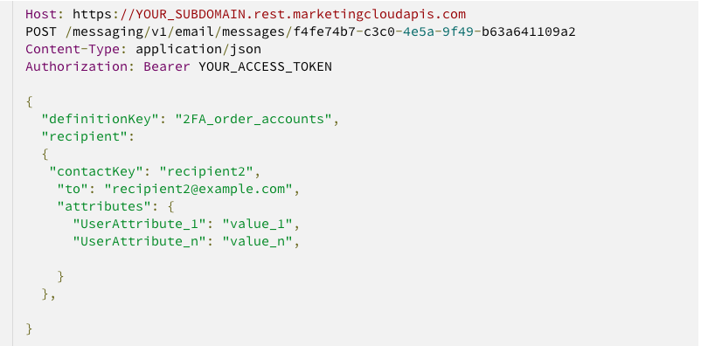
Triggered Transactional Messaging
https://developer.salesforce.com/developer-centers/marketing-cloud/
1
Complete HTML Payload
API Payload
KEY
EMAIL
HTML
Message Created
Message Sent
[CUST] Trigger
2
JSON / XML Payload w/ Transform
API Payload
Transform
KEY
EMAIL
JSON/XML
XSLT
GTL
Message Created
Message Sent
[CUST] Trigger
3
Minimal Payload w/ Template
API Payload
Template
KEY
EMAIL
VALUE/PAIRS
XSLT
GTL
Message Created
Message Sent
[CUST] Trigger
Marketing Cloud API

Slide 17

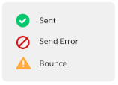
Transactional Sending Before January Release
1
Customer Event
/messaging/v1/messageDefinitionSends/{triggeredSendDefinitionId}/send
Marketing Cloud
Processing
2
NTO events such as order confirmation, purchase receipt, etc occur causing NTO to send an API call to Marketing Cloud to send a transactional message.
Marketing Cloud receives NTO’s request and responds back to NTO that the message has been queued.
1
Example Response:
2
Triggered
Send
{
"requestId": "e2ddb203-ea53-4843-b2d4-9f8c0c862913",
"responses": [ {
"recipientSendId": "e2ddb203-ea53-4843-b2d4-9f8c0c862913",
"hasErrors": false,
"messages": ["Queued"]
}]
}
Triggered
Send
Queued
API
4
NTO now wants to know the disposition of the message send. NTO makes another API call to Marketing Cloud to ask for the message status.
* Note: NTO doesn’t know how long to wait before requesting so they may have to make this call multiple times if the message is still in the queue.
Status Check
Marketing Cloud
Processing
3
/messaging/v1/messageDefinitionSends/key:{key}/deliveryRecords
As Marketing Cloud processes the queue the message is sent, errors, or bounces.
4
Request Status
3
Example Response:
Send Message
API
{
"deliveryTime": "2014-09-18T07:38:34.943",
"id": "bd52a488-2f5c-de11-92ee-001cc494ae9e",
"messageId": "a7038ea5-51b7-4574-ac22-183654378dd2",
"status": "Sent",
"to": {
"address": "example@example.com",
"id": 195711367,
"key": "example@example.com"
}
}

Slide 18
Transactional Sending After January Release
1
Customer Event
Marketing Cloud
Processing
2
NTO events such as order confirmation, purchase receipt, etc occur causing NTO to send an API call to Marketing Cloud to send a transactional message.
Marketing Cloud receives NTO’s request and responds back to NTO that the message has been queued.
1
Triggered
Send
/messaging/v1/{channel}/definitions/{definitionKey}/
2
API
Example Response:
Triggered
Send
Queued
{
"requestId": "e2ddb203-ea53-4843-b2d4-9f8c0c862913",
"responses": [ {
"recipientSendId": "e2ddb203-ea53-4843-b2d4-9f8c0c862913",
"hasErrors": false,
"messages": ["Queued"]
}]
}
4
NTO has a URL that is configured to accept POST calls from Marketing Cloud.
As Marketing Cloud processes the messages they make calls back to NTO to inform them of the message status.
4
Callback URL
https://ntoretail.com/callback
3
Marketing Cloud
Processing
As Marketing Cloud processes the queue the message is sent, errors, or bounces.
Example Response:
[{
"eventCategoryType":
"TransactionalSendEvents.EmailSent",
"timestampUTC":<timestamp>,
"compositeId":"<compositeIDString>",
"definitionId":"<defIDString>",
"definitionKey":"<definitionKeyString>",
"mid":<midNumber>,
"eid":<eidNumber>,
"info":{
"to":"<emailAddressString>",
"subscriberKey":"<subscriberKeyString>",
"messageKey":"<messageKeyString>",
"status":"Sent"
}
}]
3
Send Message

Slide 19
Marketing Cloud Architecture
Business Unit Setup - Blocks
Single-level BU block
BU Details block
Multi-tier BU block
Ent. BU
Ent. BU
BU1
BU2
BU3
BU1
BU2
BU3
BU4
Sender Authentication Package
(Shared click redirect, Shared link wrapping, unlimited FROM name)
BU1
BU2
BU3
BU4
2 Marketing IP Addresses (<6MM per day)
BU-1a
BU-2a
BU-3a
BU-4a
1 Transactional IP Address (<3MM per day)
Managed Preference Center
BU-2b
BU-3b
BU-4b
BU Level
Opt-Out
BU Level
Opt-Out
BU Level
Opt-Out
Bu-1b
BU-2c
BU-3c
BU-4c

Slide 20

















Marketing Cloud Architecture
Data and other Misc. Blocks
1
5
REST/SOAP REQUEST
9
10
CONTENT BUILDER
SYNC or ASYNC
Email
Content Blocks
Pages
Templates
DWH
CONTACT DATASET(S)
REST/SOAP RESPONSE
…
DS1
DS2
DS3
DS4
2
6
AUTOMATION STUDIO
Sales Cloud
Service Cloud
Leads, Contacts & Other
11
3
CRM
CONTACT BUILDER
Journey
Email
SMS
Mobile Push
4
12
7
8
BULK DATA INPUT
Customer Service
Outbound Messaging
EINSTEIN
Einstein scoring
Einstein STO and Frequency Capping
ETL
sFTP
IMPORT

Slide 21




AS+IS+Sitecore Integration Overview
interaction studio
Sitecore Asset Reference
6
3
DMP Segment Syncing
4
Interaction Studio Event Syncing
Reference Sitecore media in Next Best Action decisions from Interaction Studio
Interaction Studio captures Salesforce DMP segments for enhanced personalization
Send events from customer engagement across channels to DMP
5
Intelligent Journey Orchestration
dmp
Take action in Journey Builder (or any outbound channel based on up to the moment information
Invoke Marketing Cloud channels or journey from in the moment behavior
Customer Engagement
7
Sitecore/Marketing Cloud Connector
1
User Match & Impression Tracking
2
Audience Activation
Activate Marketing Cloud Audiences in DMP
Publish DMP segments to Marketing Cloud
Makes images from the Sitecore media library available in Marketing Cloud for content reuse and channel messaging
1st party user matching and behavior tracking
Channels
marketing cloud

Slide 22



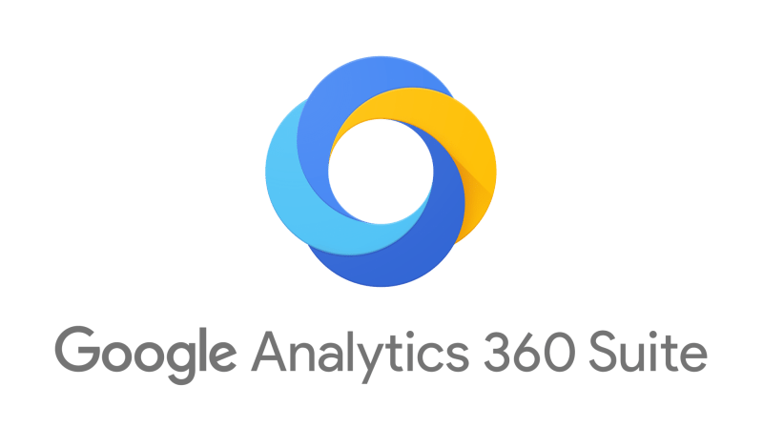

Salesforce Audience Architecture for GoDaddy
Listens for digital signals on owned properties to augment audience creation
INTERACTION STUDIO
Marketing
FTP/API
1st party audience creation
Segmentation & Targeting
Future state data layer
Messaging: Email, Mobile
Customer Data Management
Automation Studio, Journey Builder
Customer Data Analysis & Reporting
Ad Audiences
DATORAMA
Data in
Cross Channel Campaign Management
Data out
Advertising Studio
GA ID Match
GA360
1st party audience activation
ESP Capabilities
Display & Social Advertising
Hashed Email
1st party audience activation
2nd/3rd party audience activation
Search, Display, Social

Slide 23

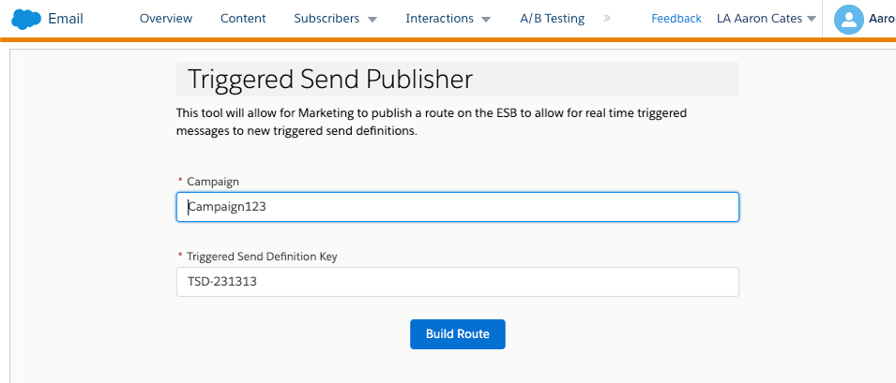

Marketing Portal To Create ESB Route
Embedded App in Marketing Cloud
2
3
Request Received
1
Transactional Send Portal
Topic/Subscription Created On ESB
Upon publish by Marketing, an API call would be made to the <customer-hosted> ESB to add a new topic/subscription.
As events are handled by the ESB, the appropriate transactional send API would be invoked. Marketing Cloud would receive the request, assemble the message, and deliver to the recipient.
An external portal that Marketing can access within Marketing Cloud would allow for details of the new send definition to be added to the ESB through a GUI interface.
MARKETING CLOUD
MARKETING CLOUD
Service Bus
Transactional
API Route 1
Transactional Send 1
API
Transactional
API Route 2
Example Payload:
Transactional Send 2
Example Payload:
API
{
"definitionKey": "tapi-survey",
"recipient":
{
"contactKey": ”123",
"to": ”email@example.com",
"attributes":{
"key1":"value1"
}
}
}
{
"definitionKey": "tapi-survey",
"campaign": “Campaign-123",
" … " : ” … "
}
.
.
.
.
.
.
.
.
.
.
Transactional Send N
Transactional
API Route N
API

Slide 24



Segment.io Integration
Marketing Cloud Source
Marketing Cloud Destination
Journeys
Identify DE
Lists and Subscribers
Campaign DE(s)
Segment
Campaigns
Platform
Sales Cloud / Service Cloud Source
Database
Sales Cloud / Service Cloud Source
Standard Objects
Data Warehouse
Leads
Custom Objects
Accounts

Slide 25


Marketing Cloud Architecture
Barclays Architecture (FSC, MC, CMS, AI)
BARCLAYS DATA RESOURCES
Salesforce Marketing Cloud
Other Systems
1
Einstein Segments
2
Contact Data
Barclays Publishing System
SUBSCRIPTIONS
MERCURY DB
AUTOMATION STUDIO
Subscription Data
…
and more…
CSV
File Drop
FTP
Data Extensions
Filter/SQL
Target Audience
EINSTEIN
Send Time Optimization
Frequency Capping
Einstein Recommendations
Leads, Contacts & Other
CONTENT BUILDER
Email
Content Blocks
Pages
Templates
Mapped Object Data
SALESFORCE ORG
FLIGHT
3
Batch
Email Recs
MC CONNECT
Standard and Custom Objects Secure API
BLADE
MESSAGING
Journey
Email
SMS
Mobile Push
HTTPS SOAP API
CSV
Opens, clicks, bounces
Batch sFTP
FTP
CSV

